Slide 1

Title: What happens at plate boundaries?
LO: Locate tectonic activity globally and describe the distribution of volcanoes and earthquakes; Explain the hazards found at each type of plate boundary
Date: Thursday 9th September 2025
Title: What happens at plate boundaries?
What are the 4 layers of the Earth called?
Which layer of the Earth is thought to be completely solid? Why do scientists think this?
How are continental plates different from oceanic plates?

Slide 2
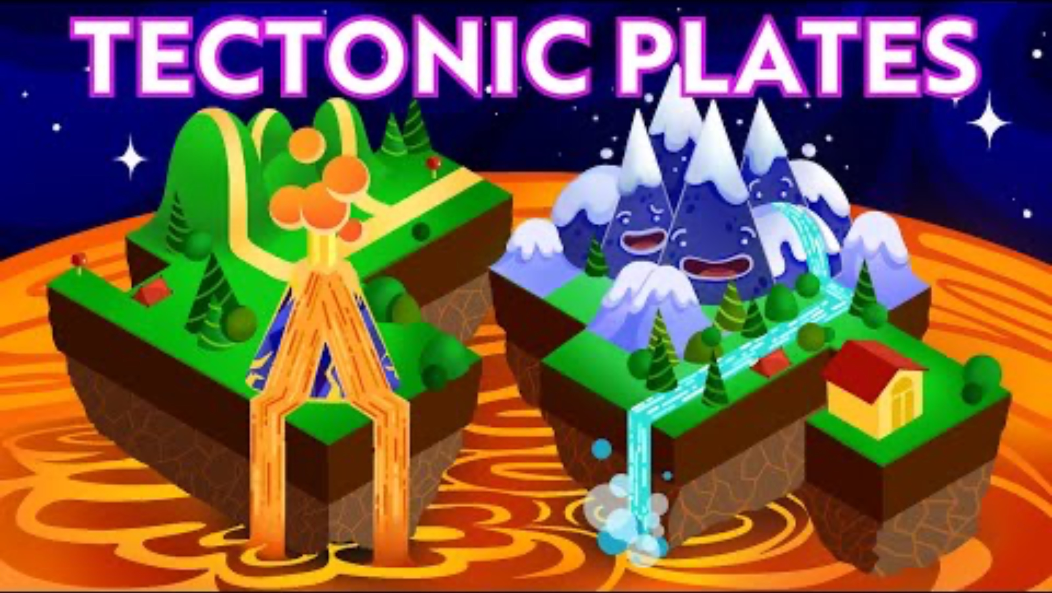
Title: What happens at plate boundaries?
LO: Locate tectonic activity globally and describe the distribution of volcanoes and earthquakes; Explain the hazards found at each type of plate boundary
Tectonic Hazards
Earth looks peaceful from space, but plates shift below. Why is curiosity important for asking questions about Earth’s hidden forces?
Wegener’s idea of drifting continents took decades to prove. How does this show perseverance is needed for scientists to discover the truth?
Plates crash, separate and slide, shaping mountains and oceans. How can this remind us of the value of working together?
Volcanoes, earthquakes, and mountains show Earth is always changing. Why is responsibility important for how we live on our planet?
Notes:
https://www.youtube.com/watch?v=xhcovHLA90s

Slide 3
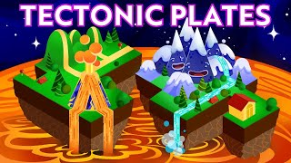
Title: What happens at plate boundaries?
LO: Locate tectonic activity globally and describe the distribution of volcanoes and earthquakes; Explain the hazards found at each type of plate boundary
Tectonic Hazards
从太空看地球看似平静，但下面的板块却在移动。为什么好奇心对于提问地球隐秘力量很重要？ 韦格纳关于漂移大陆的观点花了几十年才被证明。这表明科学家发现真相需要坚持不懈是如何必要的？ 板块碰撞、分离、滑动，塑造山脉和海洋。这如何提醒我们合作的价值？
火山、地震和山脉都显示地球在不断变化。为什么责任对我们在地球上的生活很重要？
Notes:
https://www.youtube.com/watch?v=xhcovHLA90s

Slide 4
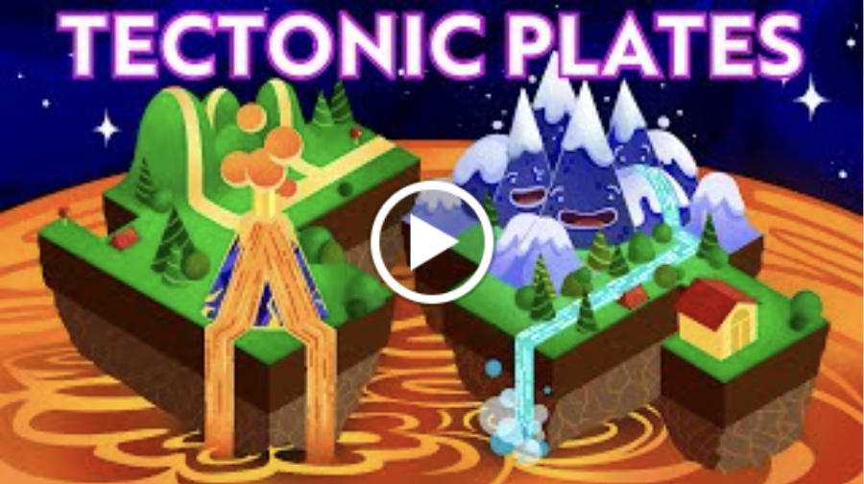
Title: What happens at plate boundaries?
LO: Locate tectonic activity globally and describe the distribution of volcanoes and earthquakes; Explain the hazards found at each type of plate boundary
Tectonic Hazards
Curiosity - It’s important to stay curious because Earth’s forces are hidden beneath the surface. Asking questions helps us understand earthquakes, volcanoes, and how our planet works.
Perseverance - Wegener’s idea was rejected at first, but he didn’t give up. Scientists had to persevere for decades to prove plate tectonics was real.
Collaboration - Tectonic plates work together to form mountains, oceans and valleys. Like them, people achieve more when they cooperate, even when there are challenges or disagreements.
Responsibility - Earthquakes, volcanoes, and plate movements can cause danger. We must take responsibility by preparing wisely and caring for the planet we all share.

Slide 5
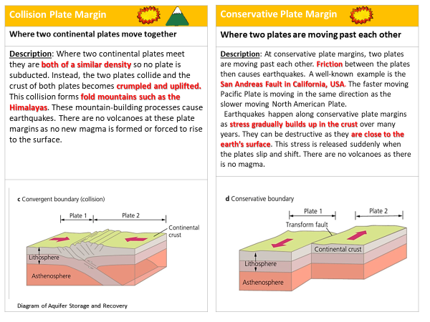
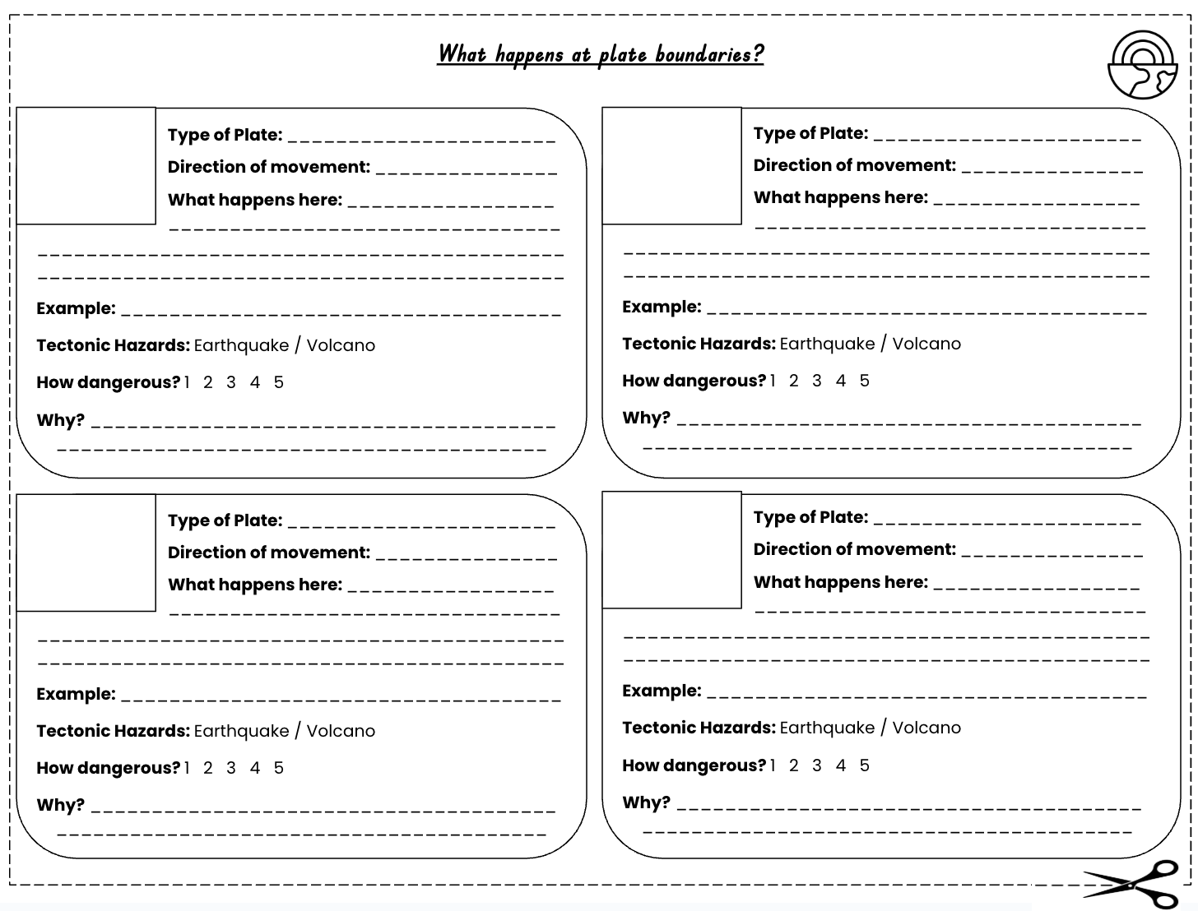
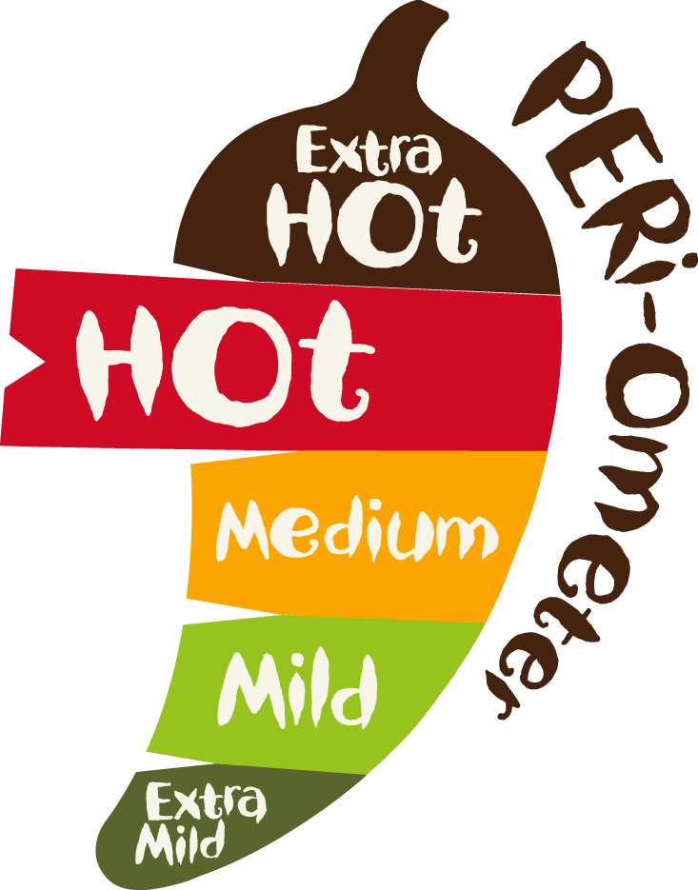

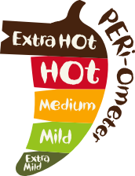
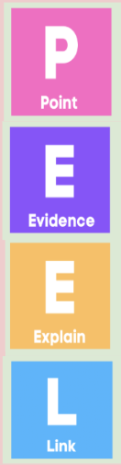
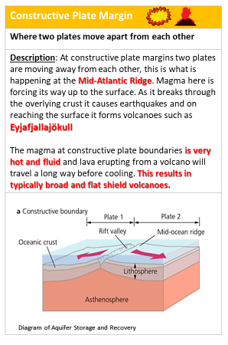
Title: What happens at plate boundaries?
LO: Locate tectonic activity globally and describe the distribution of volcanoes and earthquakes; Explain the hazards found at each type of plate boundary
What happens at plate boundaries?
Activity 1: Using the information sheets, compete your “Plate Boundaries Factfile”
Don't forget to add a sketch!
Activity 2: Write a PEEL paragraph to answer this question: “Which type of plate boundary do you think is the most dangerous, and why?”
Point – I think the most dangerous plate boundary is the…
Evidence – One example of this is… Another example is…
Explain – This shows it is dangerous because… Some people might argue that another plate boundary is more dangerous because…
Link – Overall, I believe the most dangerous plate boundary is the… because…
GCSE Exam question practise:
Explain the physical processes that happen at constructive plate boundaries.
Word Bank: plates, move apart / separate, gap / space, magma, crust, rises / pushes up, lava, erupt / eruption, earthquakes, volcanoes, shield volcanoes, hot, runny / fluid, flows far, cools

Slide 6
Title: What happens at plate boundaries?
LO: Locate tectonic activity globally and describe the distribution of volcanoes and earthquakes; Explain the hazards found at each type of plate boundary
What happens at plate boundaries?
Activity 1: Using the information sheets, compete your “Plate Boundaries Factfile”
Activity 2: Write a PEEL paragraph to answer this question: “Which type of plate boundary do you think is the most dangerous, and why?”
“你认为哪种板块边界最危险，为什么？”
重点——我认为最危险的板块边界是...... 证据——一个例子是......另一个例子是...... 解释——这说明它危险，因为......有人可能会说，另一个板块边界更危险，因为...... 林克——总体来说，我认为最危险的板块边界是......因为......
Point – I think the most dangerous plate boundary is the…
Evidence – One example of this is… Another example is…
Explain – This shows it is dangerous because… Some people might argue that another plate boundary is more dangerous because…
Link – Overall, I believe the most dangerous plate boundary is the… because…
Word Bank: plates, move apart / separate, gap / space, magma, crust, rises / pushes up, lava, erupt / eruption, earthquakes, volcanoes, shield volcanoes, hot, runny / fluid, flows far, cools

Slide 7
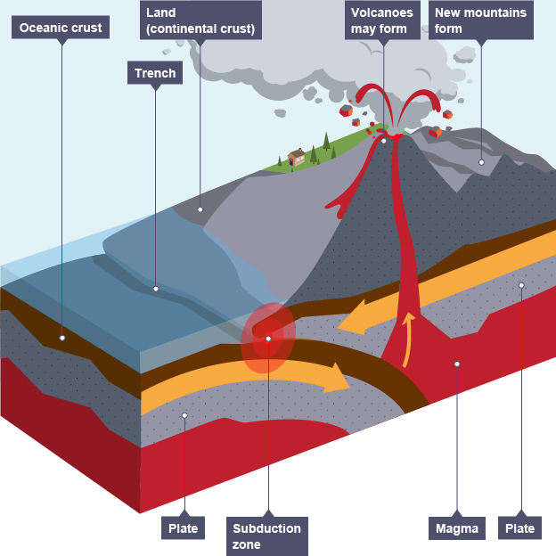
Destructive
Types of plate: Oceanic and continental
Direction of plates: Towards each other
What happens here: The denser oceanic crust is forced (subducted) under the continental plate. This generates huge amounts of heat from the mantle & friction which causes the oceanic plate to melt. This magma rises through the continental crust and forms volcanoes on the surface.
Tectonic Hazards: Earthquakes and volcanoes (also tsunamis if the earthquakes occur at sea).
Examples: New Zealand, Japan
Subduction
Where an oceanic plate is forced under a continental plate into the mantle. This happens at destructive plate boundaries.
Challenge: Rate how dangerous this plate boundary is out of 5. Explain your answer.

Slide 8
Destructive
Types of plate: Oceanic and continental
Direction of plates: Towards each other
What happens here: The denser oceanic crust is forced (subducted) under the continental plate. This generates huge amounts of heat from the mantle & friction which causes the oceanic plate to melt. This magma rises through the continental crust and forms volcanoes on the surface.
Tectonic Hazards: Earthquakes and volcanoes (also tsunamis if the earthquakes occur at sea).
Examples: New Zealand, Japan
Challenge: Rate how dangerous this plate boundary is out of 5. Explain your answer.

Slide 9
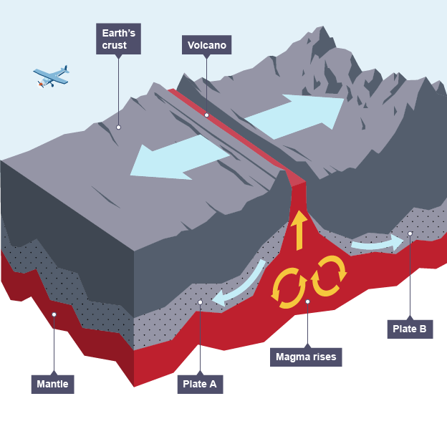
Constructive
Types of plate: Oceanic-oceanic, or continental-continental
Direction of plates: Away from each other
What happens here: As the plates move apart magma breaks through the crust and rises to the surface and solidifies forming shield volcanoes on the surface.
Tectonic Hazards: Earthquakes (small) and shield volcanoes (not very powerful).
Examples: Iceland, East African Rift Valley
Challenge: Rate how dangerous this plate boundary is out of 5. Explain your answer.

Slide 10
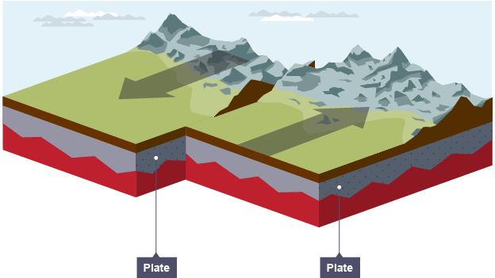
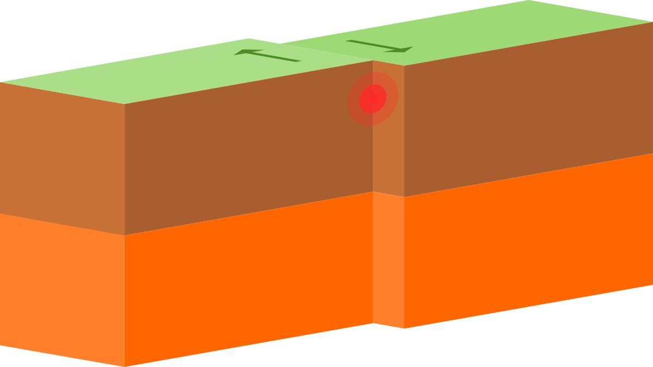
Conservative
Types of plate: Oceanic-oceanic, continental-continental
Direction of plates: Side by side
What happens here: Two plates are moving past each other (side by side) in either opposite directions or the same direction but at different speeds. This can cause a huge build up of pressure which is released as an earthquake.
Tectonic Hazards: Earthquakes (can be very powerful)
Examples: San Andreas fault (California).
Challenge: Rate how dangerous this plate boundary is out of 5. Explain your answer.

Slide 11
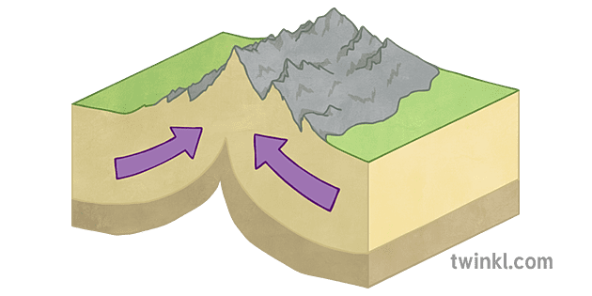
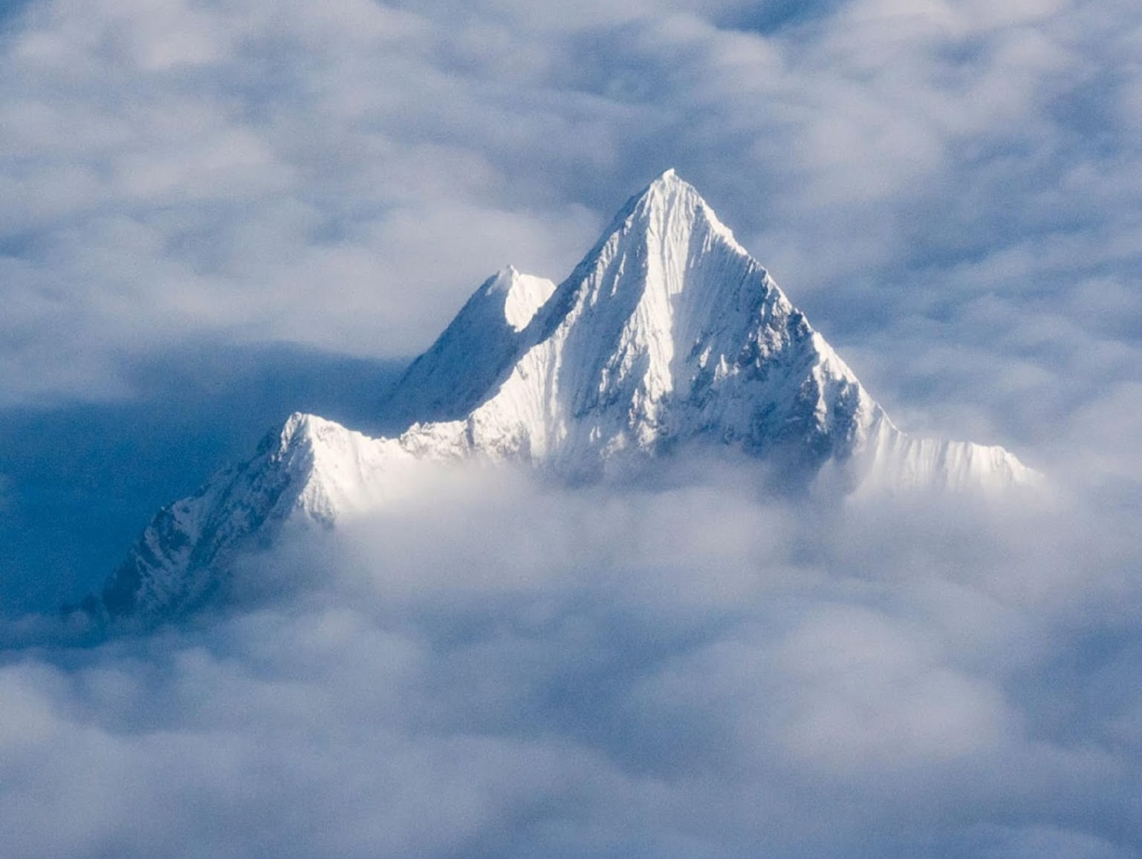
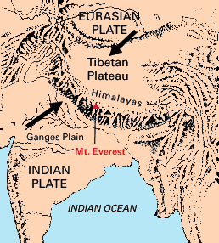
Collision
Types of plate: Continental-continental
Direction of plates: Towards each other
What happens here: Two continental plates are moving towards each other, but because neither is more or less dense they fold up creating mountains.
Tectonic Hazards: Earthquakes (can be very powerful)
Examples: Himalayan mountain range (Mt Everast)
Challenge: Rate how dangerous this plate boundary is out of 5. Explain your answer.

Slide 12
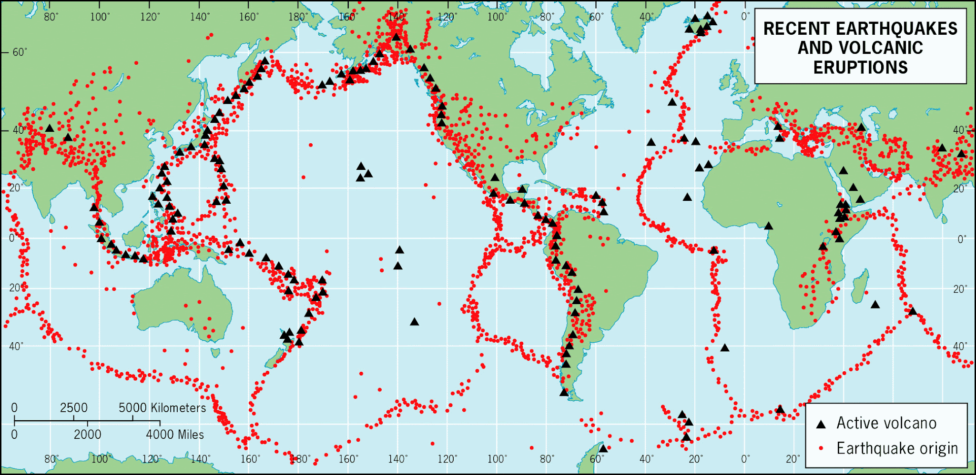
Title: What happens at plate boundaries?
LO: Locate tectonic activity globally and describe the distribution of volcanoes and earthquakes; Explain the hazards found at each type of plate boundary
Geo skills: The Anomalies (Unusual Pattern)!
Most earthquakes volcanoes are created along tectonic plate boundaries, there are anomalies. Islands such as Hawaii (1), Pitcairn (2) and Samoa (3) are known as hotspot volcanoes.
1
3
2
Where do you see most of the earthquakes and volcanoes on the map? Are they spread out or grouped in certain places?
What do you notice about their location compared to the edges of the continents and oceans?

Slide 13
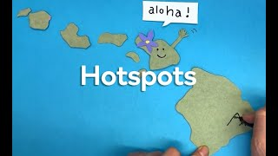
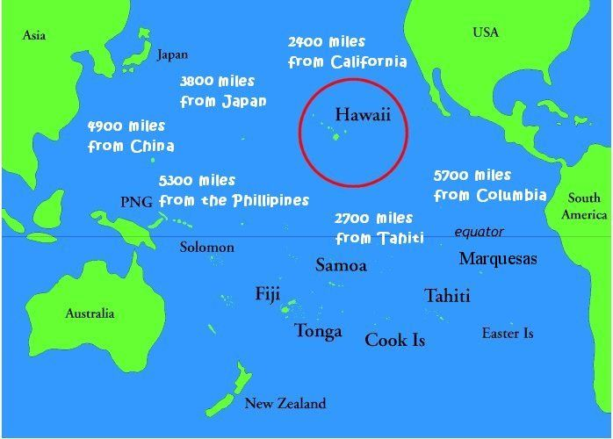
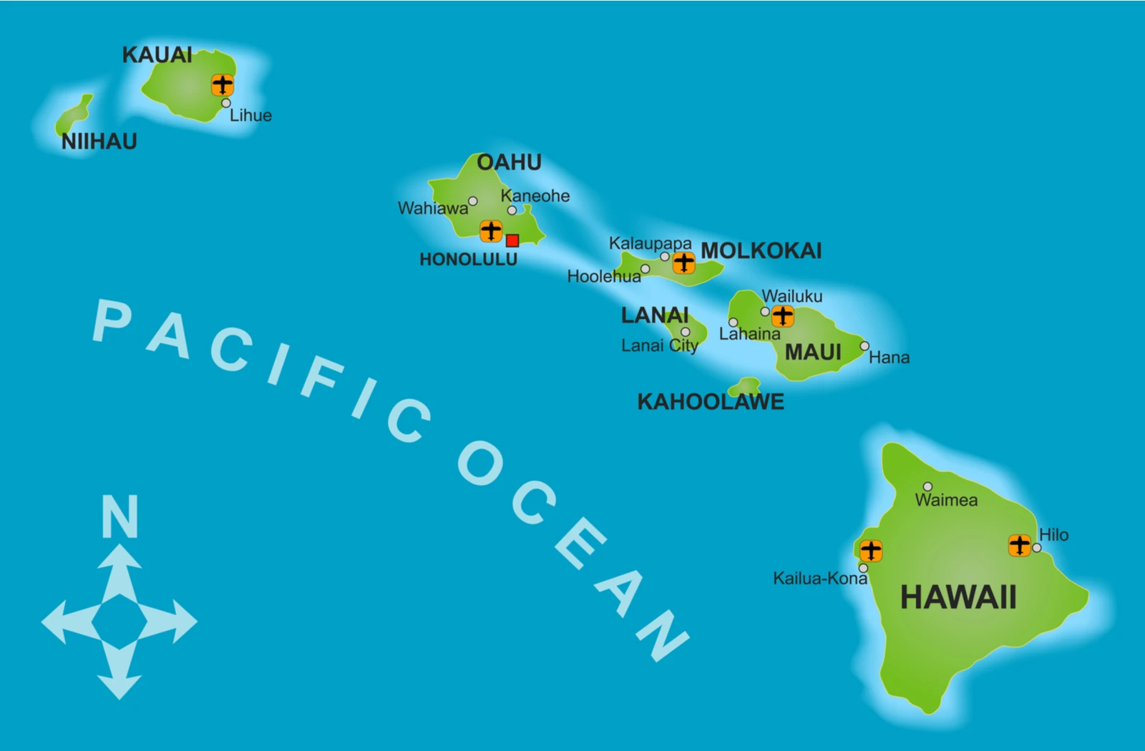
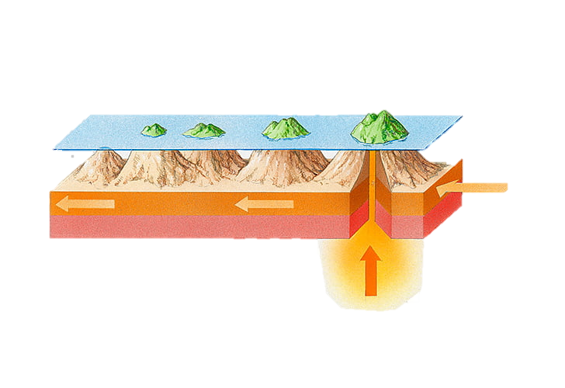
Title: What happens at plate boundaries?
LO: Locate tectonic activity globally and describe the distribution of volcanoes and earthquakes; Explain the hazards found at each type of plate boundary
Geo skills: The Anomalies (Unusual Pattern) - Hotspots!
The Hawaiian islands in the Pacific Ocean are a good example of a hot spot.
As the movement of the plate moves the islands away from the hotspot a volcanic chain of islands is formed.

Slide 14
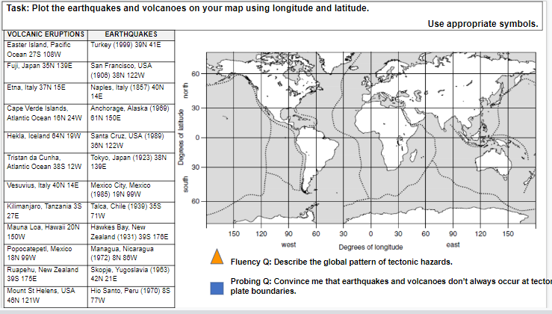
Title: What happens at plate boundaries?
LO: Locate tectonic activity globally and describe the distribution of volcanoes and earthquakes; Explain the hazards found at each type of plate boundary
Geo skills: Plotting Tectonic Hazards
Activity 3: Use latitude and longitude to mark the major volcanic eruptions and earthquakes on your map.
Latitude: Imaginary lines that run east–west around the Earth, showing how far north or south a place is from the Equator.
Longitude: Imaginary lines that run north–south, showing how far east or west a place is from the Prime Meridian.
Activity 4: Describe the global pattern of tectonic hazards. Use the word bank to help you.
Explain why earthquakes and volcanoes are often found in these places.

Slide 16


Title: What happens at plate boundaries?
LO: Locate tectonic activity globally and describe the distribution of volcanoes and earthquakes; Explain the hazards found at each type of plate boundary
Odd One Out?
1
Magma
Lava
Fold mountains
Shield volcano
2
Subduction
Ocean trench
Composite volcano
Earthquake
3
Constructive
Destructive
Collision
Conservative
4
San Andreas Fault
Himalayas
Mid-Atlantic Ridge
Andes Mountains

